Slide 1
Unit 7: Naïve Bayes

Slide 2
The Data Science Pipeline

Slide 3
A Medical Test
Bob thinks he might have a rare disease. He decides to take a test for this disease and the test comes back positive. Bob decides to read a little more about the test and discovers:
For those that have the disease, 90% will test positive (indicating the presence of the disease).
For those that do not have the disease, 80% will test negative (indicating the absence of the disease).
Should Bob be worried?

Slide 4


A Medical Test
Bob thinks he might have a rare disease. He decides to take a test for this disease and the test comes back positive. Bob decides to read a little more about the test and discovers:
For those that have the disease, 90% will test positive (indicating the presence of the disease).
For those that do not have the disease, 80% will test negative (indicating the absence of the disease).
Should Bob be worried?
$$P \left(+ | D\right)= .9$$
$P \left(− | ND\right)= .8$ P(+|ND)=.2

Slide 5
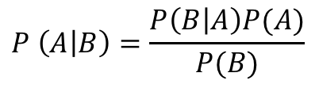
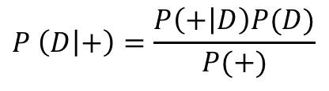
A Medical Test
Bob thinks he might have a rare disease. He decides to take a test for this disease and the test comes back positive. Bob decides to read a little more about the test and discovers:
For those that have the disease, 90% will test positive (indicating the presence of the disease).
For those that do not have the disease, 80% will test negative (indicating the absence of the disease).
Should Bob be worried?
What he really wants to know is the probability that he has the disease given that he tested positive. P( D | + )
$$P \left(A | B\right)=\frac{P\left(B | A\right)P(A)}{P(B)}$$
$$P \left(D | +\right)=\frac{P\left(+ | D\right)P(D)}{P(+)}$$
We need more information!

Slide 6


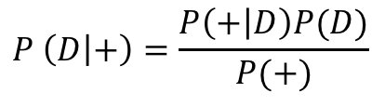
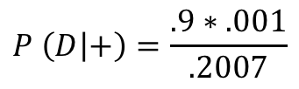

A Medical Test
Bob thinks he might have a rare disease. He decides to take a test for this disease and the test comes back positive. Bob decides to read a little more about the test and discovers:
For those that have the disease, 90% will test positive (indicating the presence of the disease).
For those that do not have the disease, 80% will test negative (indicating the absence of the disease).
Should Bob be worried?
What he really wants to know is the probability that he has the disease given that he tested positive. P( D | + )
$$P \left(D | +\right)=\frac{P\left(+ | D\right)P(D)}{P(+)}$$
$$P\left(+ | D\right)=.9 P\left(− | D\right)= .1$$
$$P\left(D\right)=.001$$
$$P\left(+\right)=P\left(+ | D\right)∗P\left(D\right)+P\left(+ | ND\right)∗P\left(ND\right)=.9∗.001+.2∗.999= .2007$$
$$P \left(D | +\right)=\frac{.9∗.001}{.2007}$$
$=\frac{.009}{.2007}$ = .045

Slide 7
Example

Slide 8
Example: Volleyball
Outlook | Wind | Volleyball
Sunny | Low | Yes
Sunny | Hi | No
Sunny | Hi | Yes
Cloudy | Low | Yes
Cloudy | Low | No
Cloudy | Low | Yes
Cloudy | Hi | Yes
Rain | Hi | No
Rain | Hi | No
Rain | Low | Yes
What is the probability that if it is Sunny and the Wind is High that Sammy will play volleyball?

Slide 9
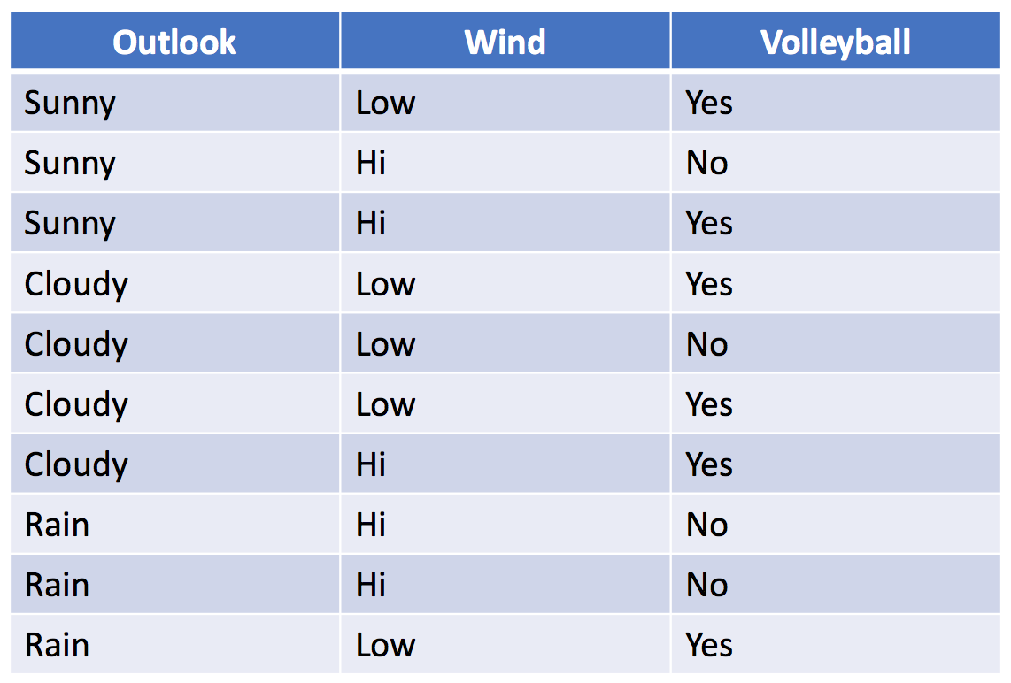
Example: Volleyball
The Naïve in Naïve Bayes means that we are
assuming that the explanatory variables are
Independent.
What is the probability that if it is Sunny and the Wind is High that he will play volleyball?
If we just look at the table, we might say 50% since we only observed two days that were Sunny and High wind and Sammy only played on one of those days.
But we have 8 more observations and of the 3 Sunny days Sammy played on 66% of them and on the 5 highly windy days Sammy only played on 40% of them.
We are basing our estimate on only two observations. Let’s use all the information!

Slide 10
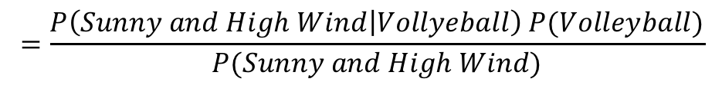

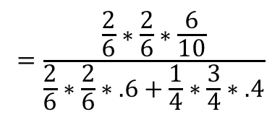
Example: Volleyball
The “Naïve” in Naïve Bayes means that we are
assuming that the explanatory variables are
Independent:
P(Outlook and Wind | Vball)
= P(Outlook | Vball ) * P(Wind | vball)
What is the probability that if it is Sunny and the Wind is High that he will play volleyball?
$$P \left(Volleyball | Outlook=Sunny and Wind=High\right)$$
$$=\frac{P\left(Sunny and High Wind | Vollyeball\right) P(Volleyball)}{P(Sunny and High Wind)}$$
$$=\frac{P\left(Sunny | Vollyeball\right)P\left(High Wind | Vollyeball\right)P(Volleyball)}{P\left(Sunny|Vball\right)P(HighWind|Vball)P\left(Vball\right)+P\left(Sunny|No Vball\right)P(HighWind|No Vball)P\left(No Vball\right)}$$
$$=\frac{\frac{2}{6}∗\frac{2}{6}∗\frac{6}{10}}{\frac{2}{6}∗\frac{2}{6}∗.6+\frac{1}{4}∗\frac{3}{4}∗.4}$$
$$=.4706$$

Slide 11
Break Out 1

Slide 12
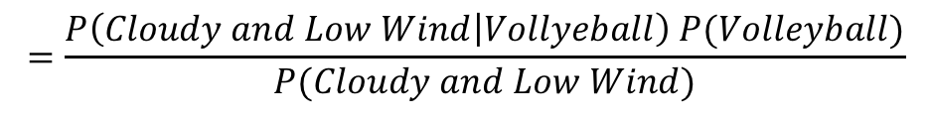

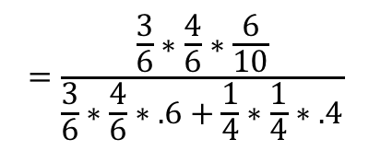
Example: Volleyball
The “Naïve” in Naïve Bayes means that we are
assuming that the explanatory variables are
Independent:
P(Outlook and Wind | Vball)
= P(Outlook | Vball ) * P(Wind | vball)
What is the probability that if it is Cloudy and the Wind is Low that he will play volleyball?
$$P \left(Volleyball | Outlook=Cloudy and Wind=Low\right)$$
$$=\frac{P\left(Cloudy and Low Wind | Vollyeball\right) P(Volleyball)}{P(Cloudy and Low Wind)}$$
$$=\frac{P\left(Cloudy | Vollyeball\right)P\left(Low Wind | Vollyeball\right)P(Volleyball)}{P\left(Cloudy|Vball\right)P(LowWind|Vball)P\left(Vball\right)+P\left(Cloudy|No Vball\right)P(LowWind|No Vball)P\left(No Vball\right)}$$
$$=\frac{\frac{3}{6}∗\frac{4}{6}∗\frac{6}{10}}{\frac{3}{6}∗\frac{4}{6}∗.6+\frac{1}{4}∗\frac{1}{4}∗.4}$$
$$=.889$$

Slide 13
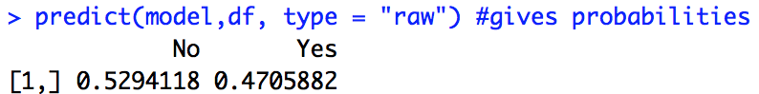
Example: Volleyball with naiveBayes()
# Unit 9 Naive Bayes Classifier
vball = read.csv(file.choose(),header = TRUE)
vball
install.packages("e1071") #naiveBayes()
library(e1071)
model = naiveBayes(Volleyball~.,data = vball)
df = data.frame(Outlook = ”Sunny", Wind = "Hi")
predict(model,df) #just classifications
predict(model,df, type = "raw") #gives probabilities
The posterior probability associated with playing volleyball on a Sunny and highly windy day is .4706 which is less than the posterior probability of not playing volleyball in the same conditions. For this reason we will predict that Sammy will not play volleyball on this day ... although we are not extremely confident in this prediction.

Slide 14
Example: New York Times Article Classification
Introduction

Slide 15

Example: NYT Article Classification
Article | Label | Snippet
1 | N | The crime was in Central Park
2 | O | What do you think about crime?
3 | N | the crime in Central Park is
4 | N | the jogger was last seen
5 | O | One mans thoughts on the central
The crime was in Central Park
$P\left(N | W\right)=\frac{P(W|N)P(N)}{P(W)}= \frac{\left(1\right)(.6)}{(.8)}+\frac{\left(.66\right)(.6)}{(.6)}+\frac{\left(.66\right)(.6)}{(.4)}\text{+}$ $\frac{\left(.66\right)(.6)}{(.4)}$ + $\frac{ ()()}{()} + \frac{() ()}{()}$
$P\left(O | W\right)=\frac{P(W|O)P(O)}{P(W)}= \frac{\left(.5\right)(.4)}{(.8)}+\frac{\left(.5\right)(.4)}{(.6)}+\frac{\left(0\right)(.4)}{(.4)}\text{+}$ $\frac{\left(0\right)(.4)}{(.4)}$ + $\frac{() ()}{()} + \frac{() ()}{()}$
$Article 1: P\left(N | W\right)$ > $P\left(O | W\right)$

Slide 16
Break Out 2

Slide 17
Example: NYT Article Classification
Article | Label | Snippet
1 | N | The crime was in Central Park
2 | O | What do you think about crime?
3 | N | the crime in Central Park is
4 | N | the jogger was last seen
5 | O | One mans thoughts on the central
The crime was in Central Park
$P\left(N | W\right)=\frac{P(W|N)P(N)}{P(W)}= \frac{\left(1\right)(.6)}{(.8)}+\frac{\left(.66\right)(.6)}{(.6)}+\frac{\left(.66\right)(.6)}{(.4)}\text{+}$ $\frac{\left(.66\right)(.6)}{(.4)}$ + $\frac{\left(.66\right)(.6)}{(.6)} +\frac{\left(.66\right)(.6)}{(.4)}$
$P\left(O | W\right)=\frac{P(W|O)P(O)}{P(W)}= \frac{\left(.5\right)(.4)}{(.8)}+\frac{\left(.5\right)(.4)}{(.6)}+\frac{\left(0\right)(.4)}{(.4)}\text{+}$ $\frac{\left(0\right)(.4)}{(.4)}$ + $\frac{\left(.5\right)(.4)}{(.6)} + \frac{\left(0\right)(.4)}{(.4)}$
$Article 1: P\left(N | W\right)$ > $P\left(O | W\right)$

Slide 18
Example: New York Times Article Classification
R Code Implementation

